Slide 1
Osobnosti EU

Slide 2
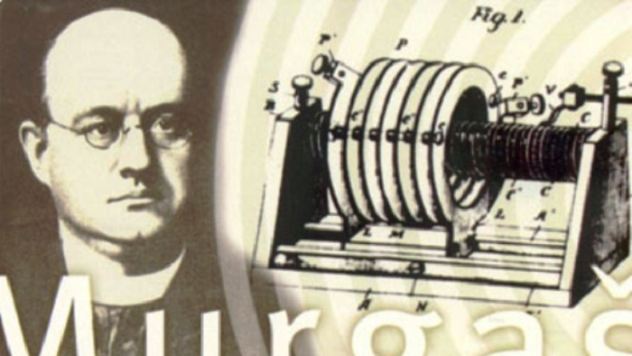
JOZEF MURGAŠ

Slide 3
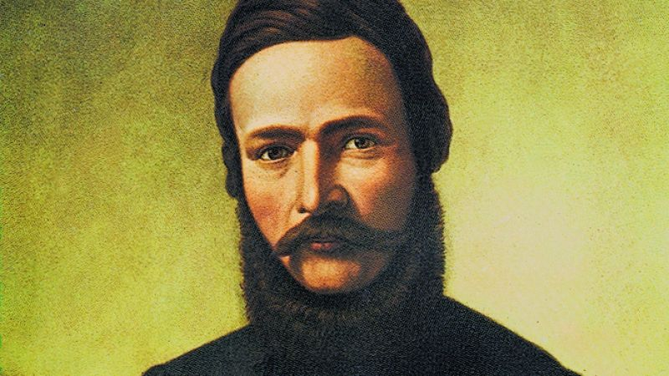
ĽUDOVÍT ŠTÚR

Slide 4
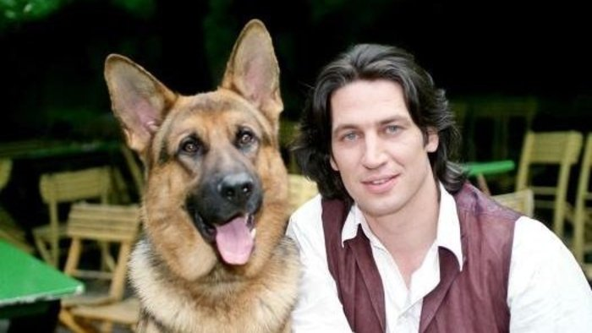
TOBIAS MORETTI

Slide 5
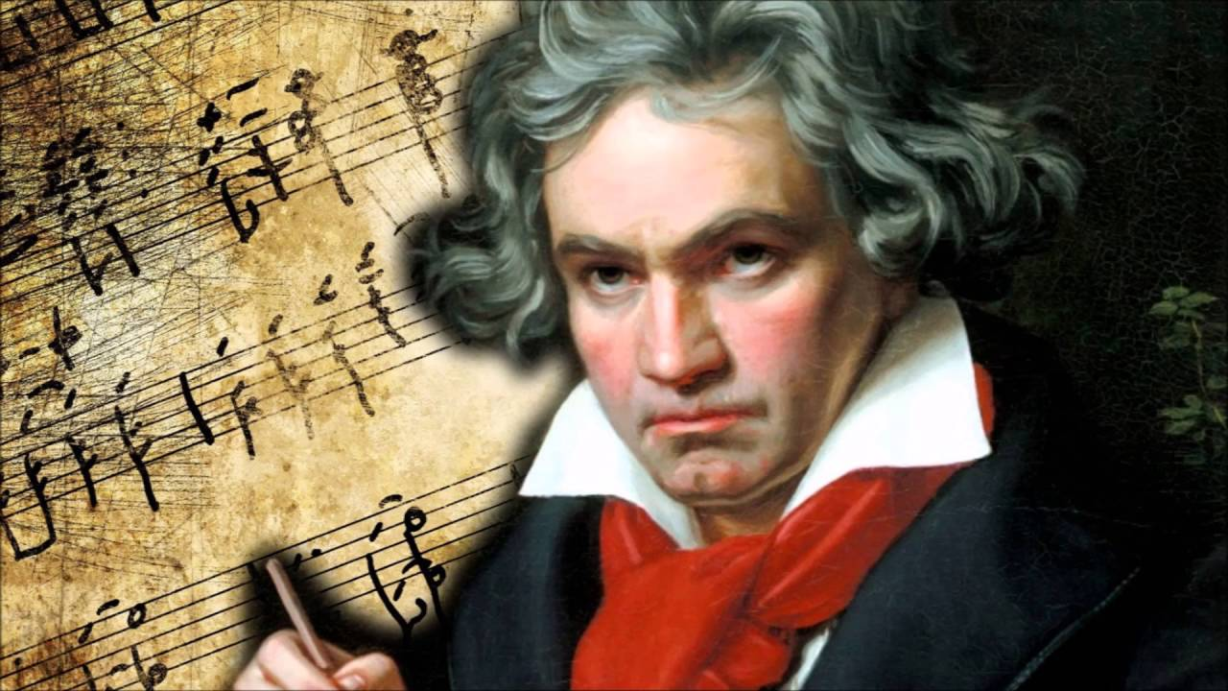
LUDVIG van BEETHOVEN

Slide 6
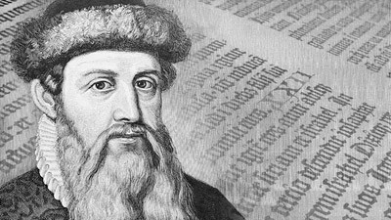
JOHANES GUTENBERG

Slide 7
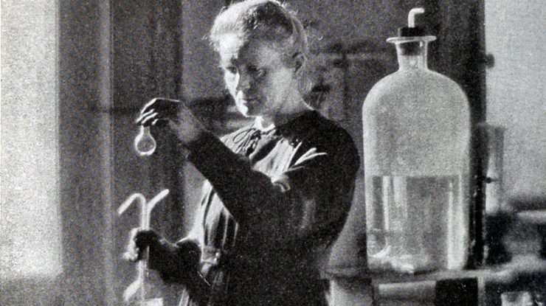
MARIA CURIE SKLODOWSKÁ

Slide 8
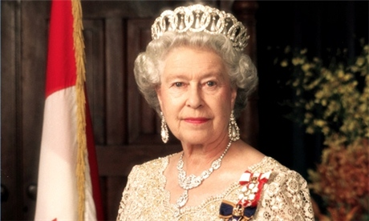
ALŽBETA II.

Slide 9
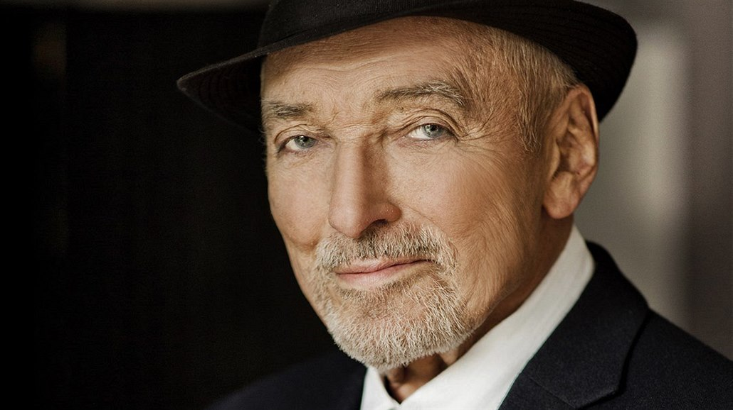
KAREL GOTT

Slide 10
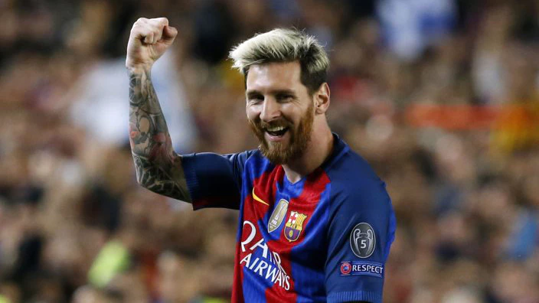
LIONEL MESSI

Slide 11
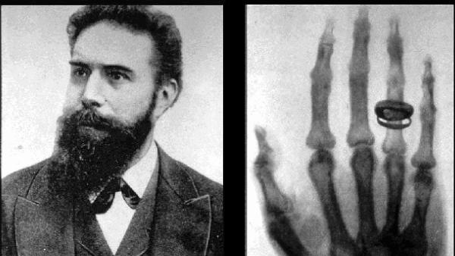
WILHEM RÖENTGEN

Slide 12
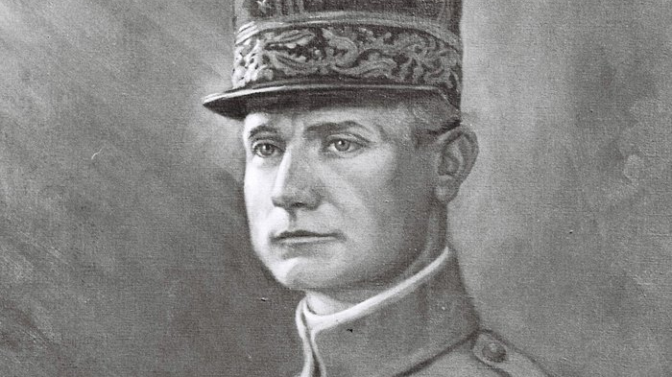
MILAN RASTISLAV ŠTEFÁNIK

Slide 13
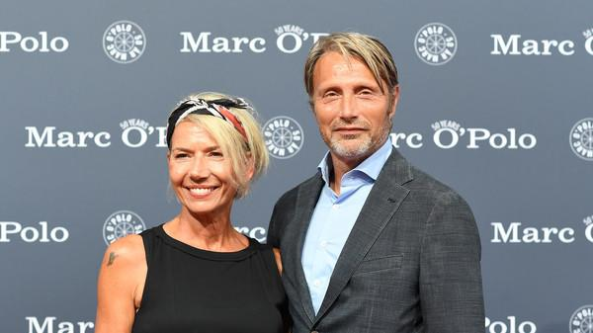
HANNE JACOBSEN

Slide 14
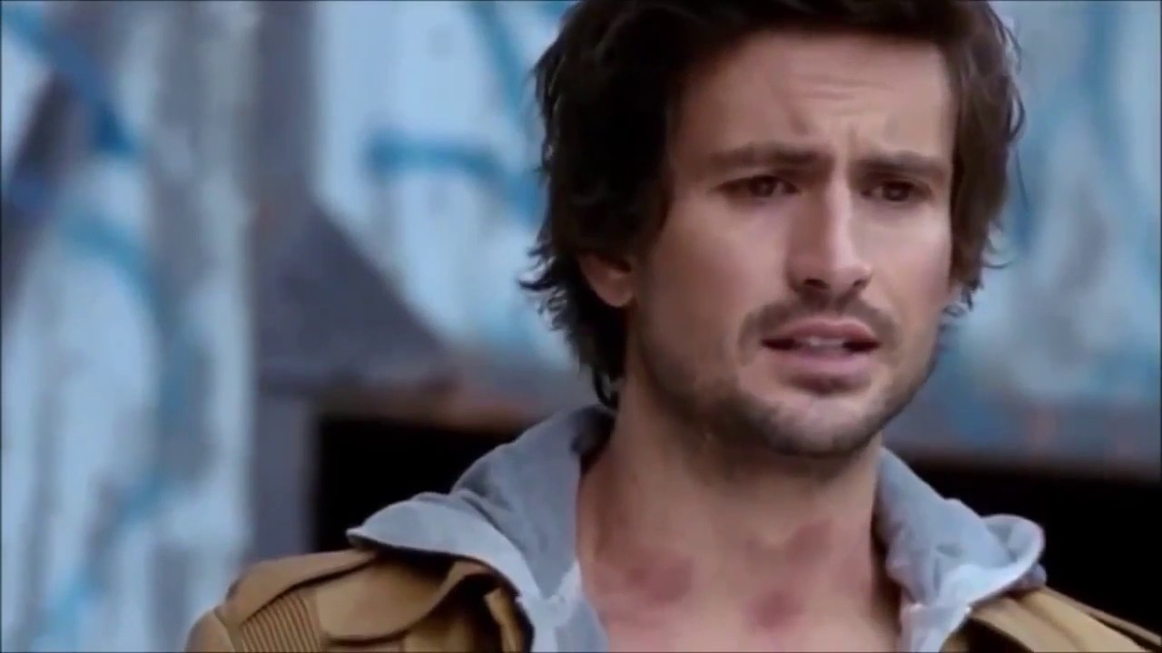
TOM BECK

Slide 15
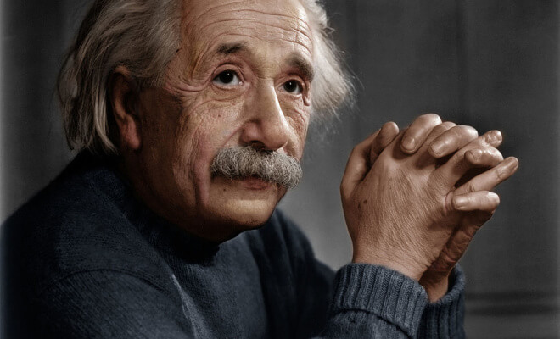
ALBERT EINSTEIN

Slide 16
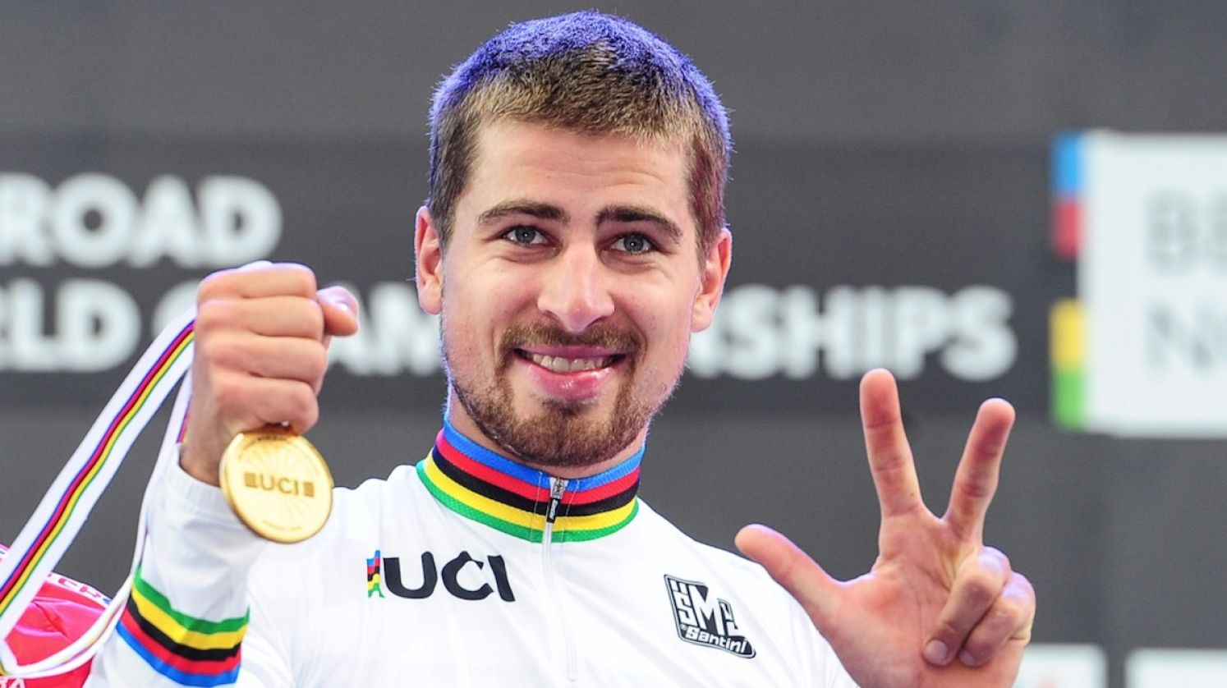
PETER SAGAN

Slide 17
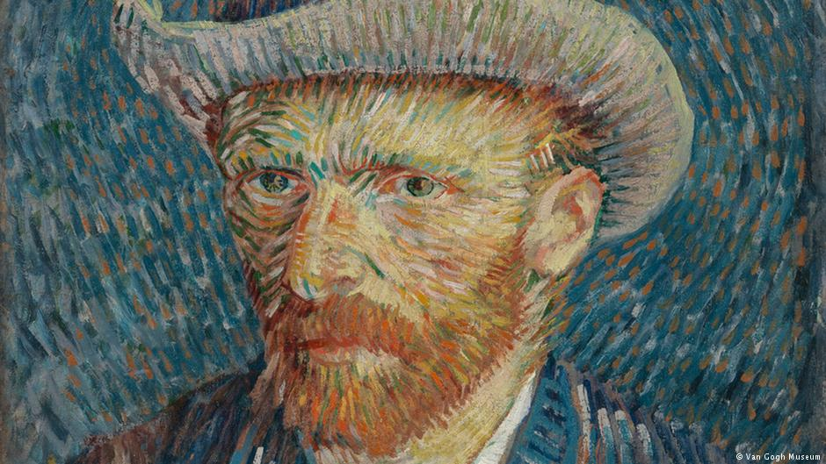
VINCENT VAN GOGH

Slide 18
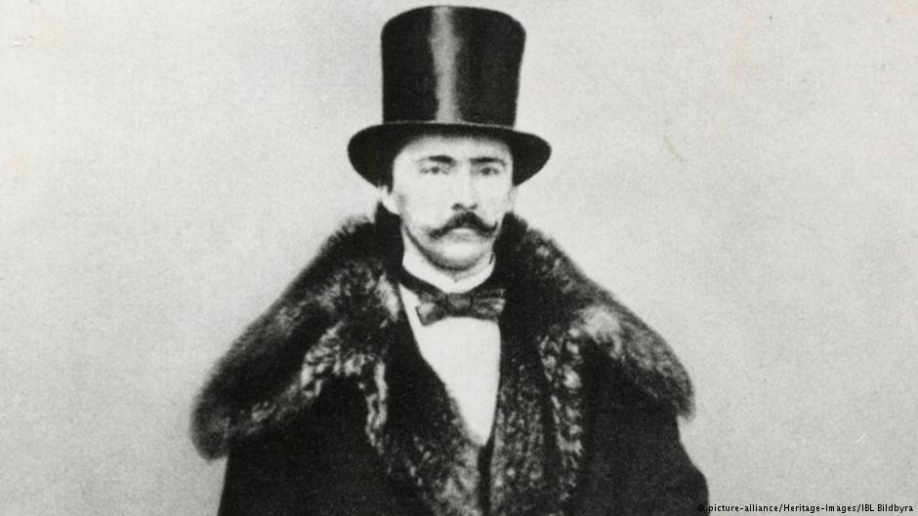
HEINRICH SCHLIMANN

Slide 19
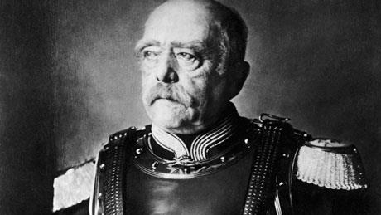
OTTO VON BISMARCK

Slide 20
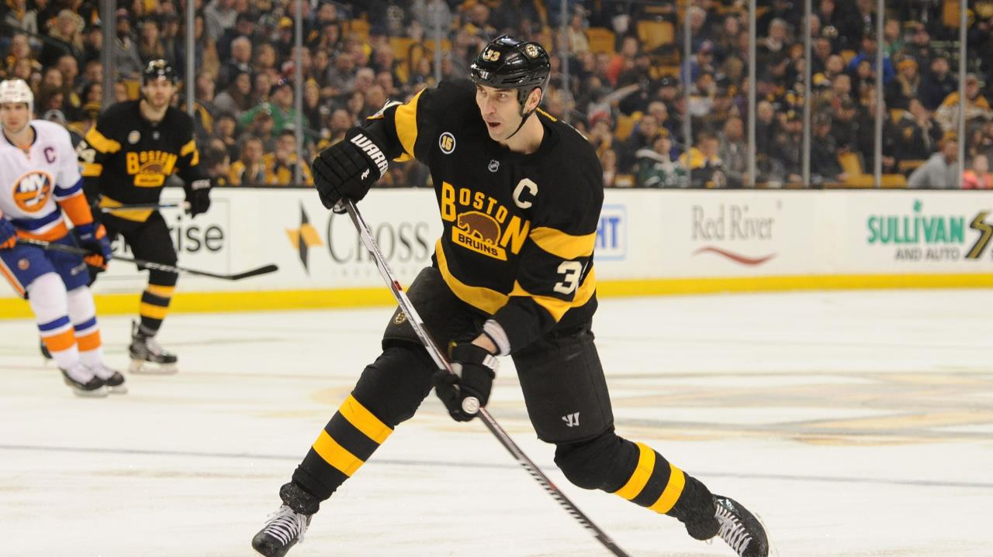
ZDENO CHARA

Slide 21
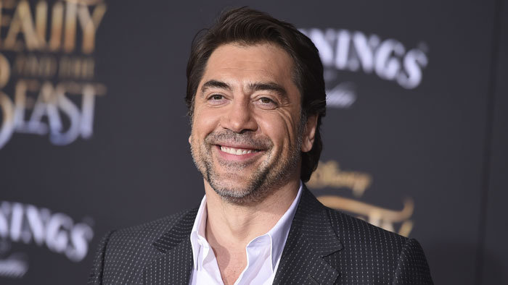
JAVIER BARDEN

Slide 22
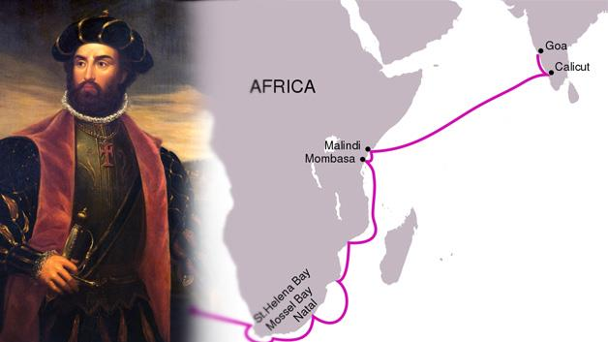
VASCO DA GAMA

Slide 23
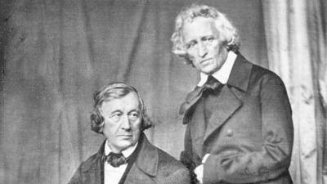
BRATIA GRIMMOVCI

Slide 24
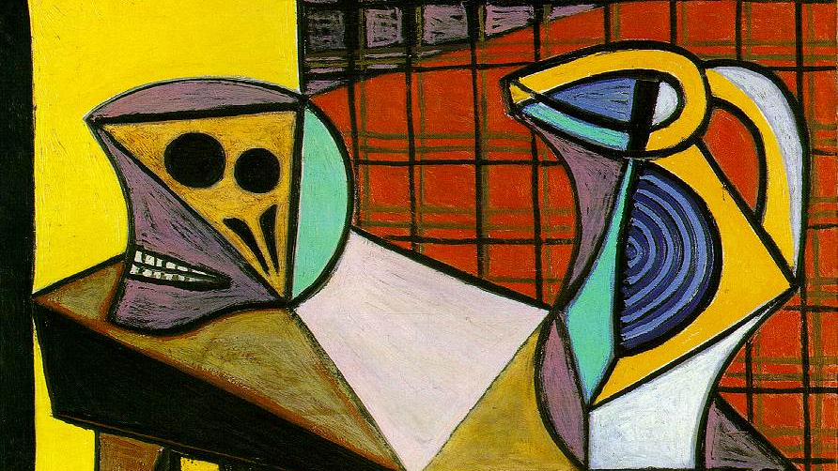
PABLO PICASSO

Slide 25
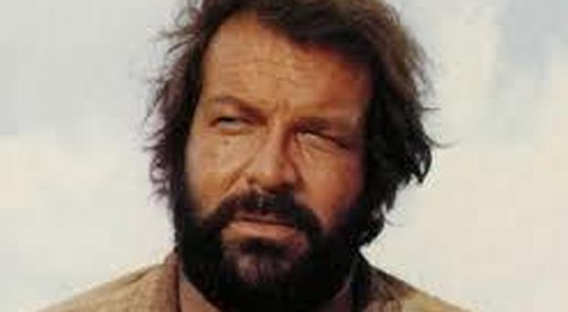
BUD SPENCER

Slide 26
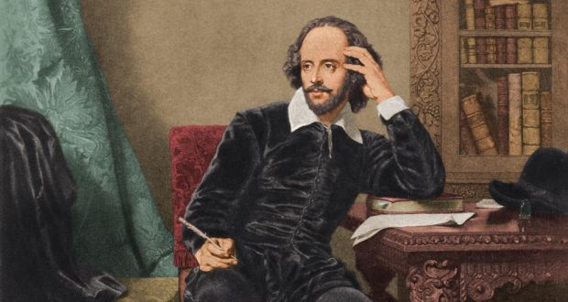
WILLIAM SHAKESPEARE

Slide 27
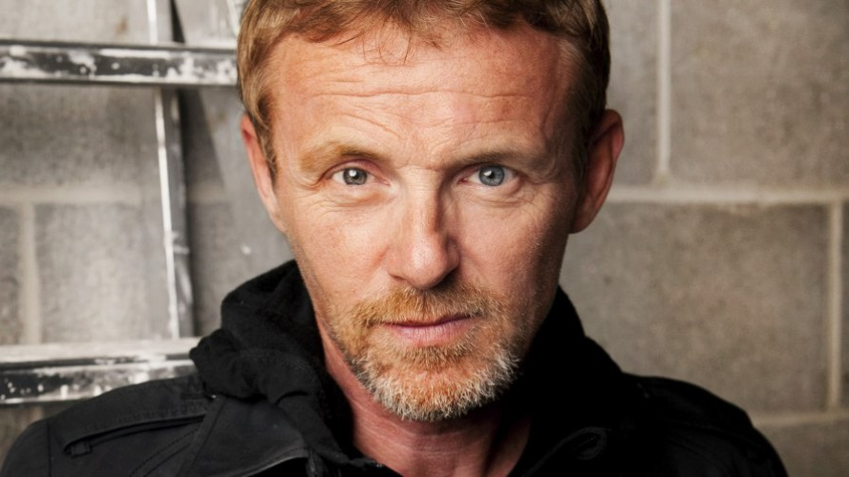
JO NESBO

Slide 28
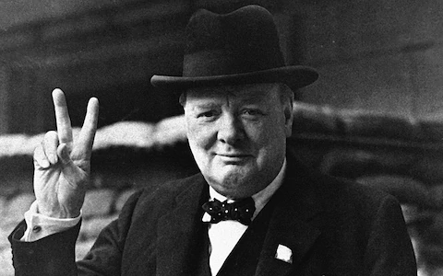
WINSTON CHURCHILL

Slide 29
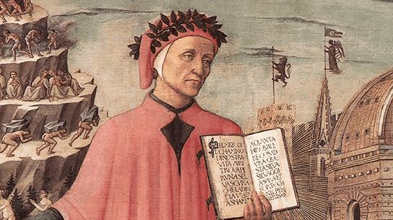
DANTE ALIGHIERI

Slide 30
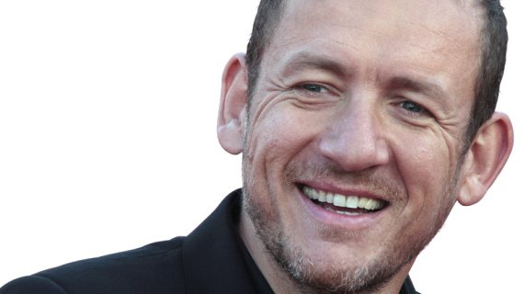
DANY BOON

Slide 31
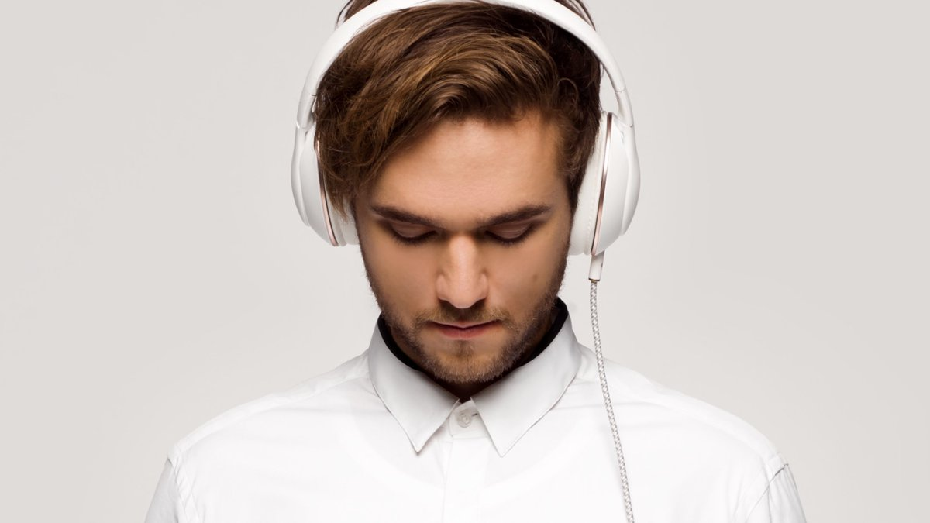
ZEDD

Slide 32
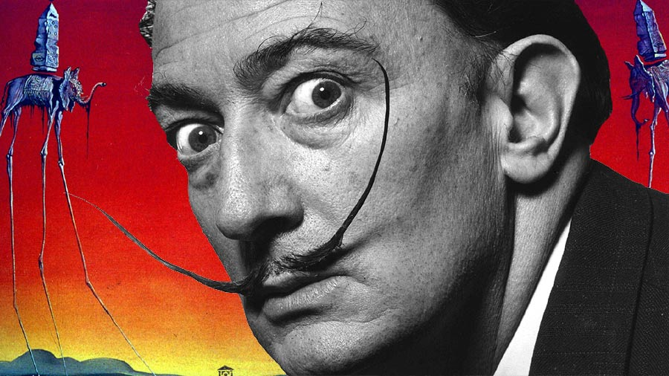
SALVADOR DALI

Slide 33
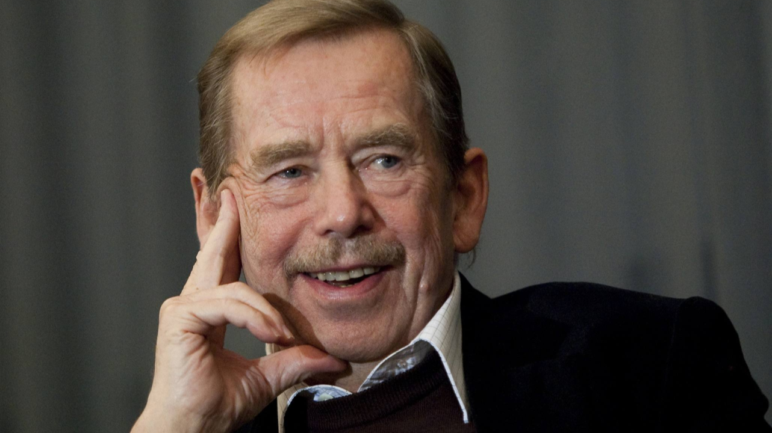
VÁCLAV HAVEL

Slide 34
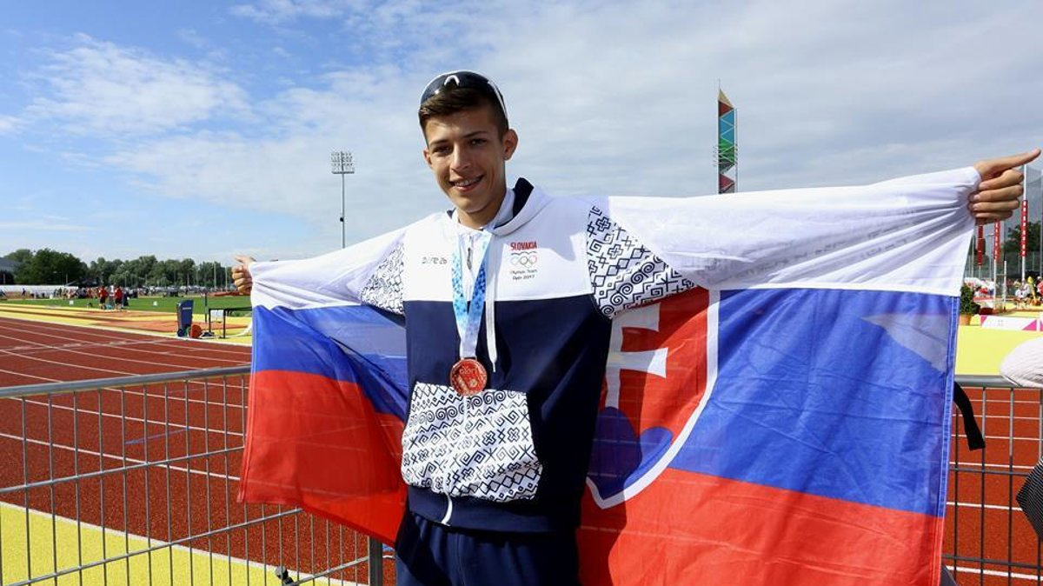
ANDREJ PAULÍNY

Slide 35
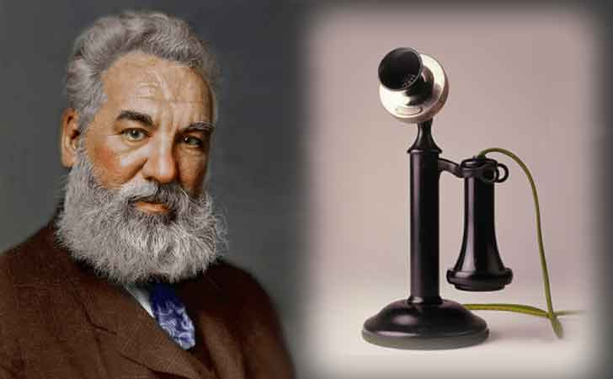
ALEXANDER GRAHAM BELL

Slide 36
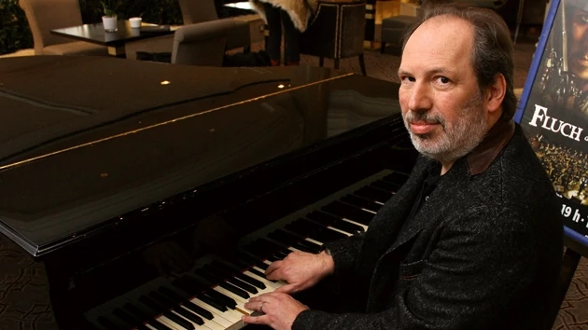
HANS ZIMMER

Slide 37
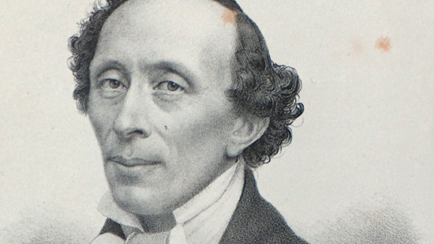
HANS CHRISTIAN ANDERSEN

Slide 38
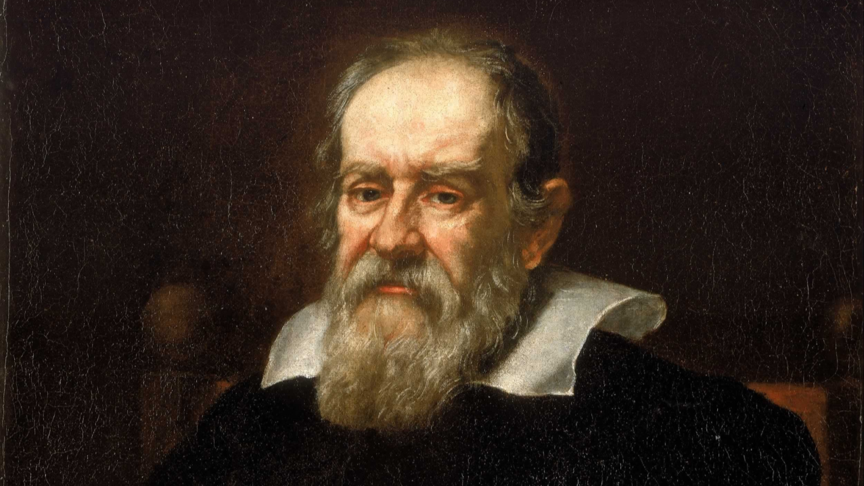
GALILEO GALILEI

Slide 39
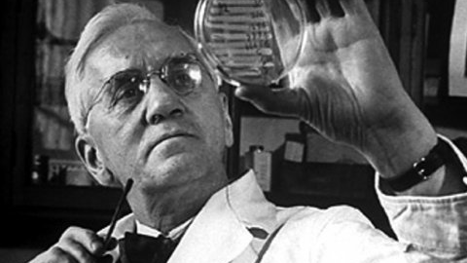
ALEXANDER FLEMING

Slide 40
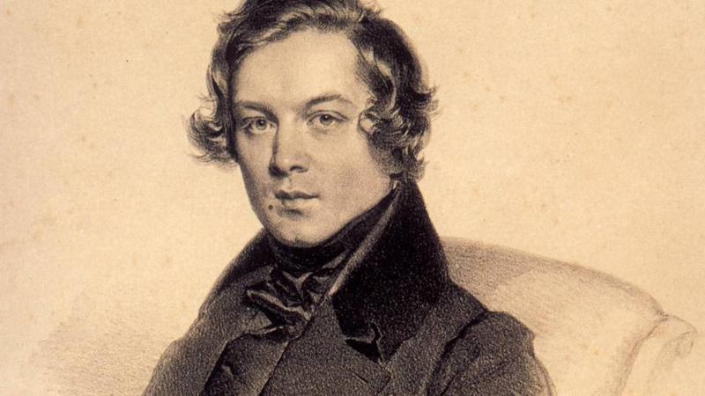
ROBERT SCHUMANN

Slide 41
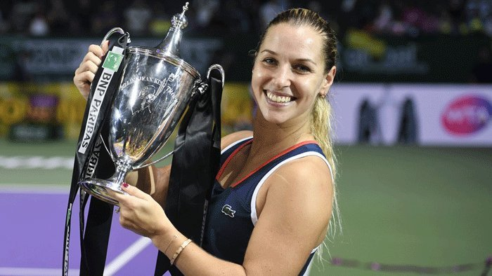
DOMINIKA CIBULKOVÁ

Slide 42
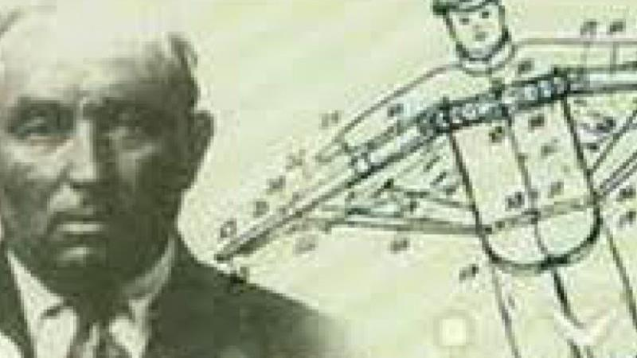
ŠTEFAN BANIČ

Slide 43
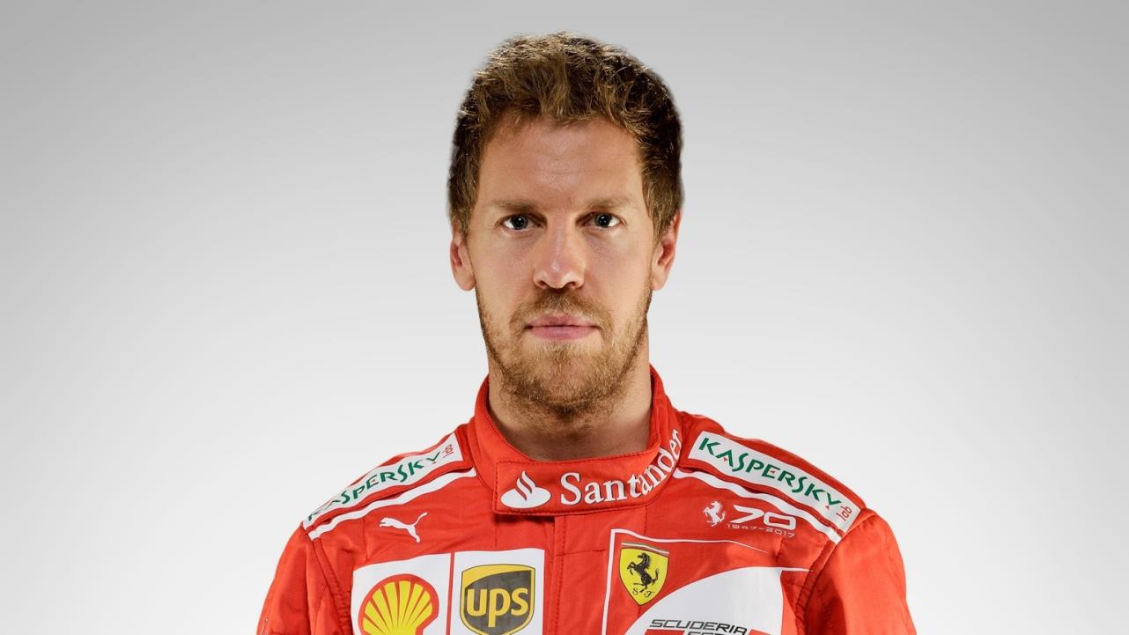
SEBASTIAN VETTEL

Slide 44
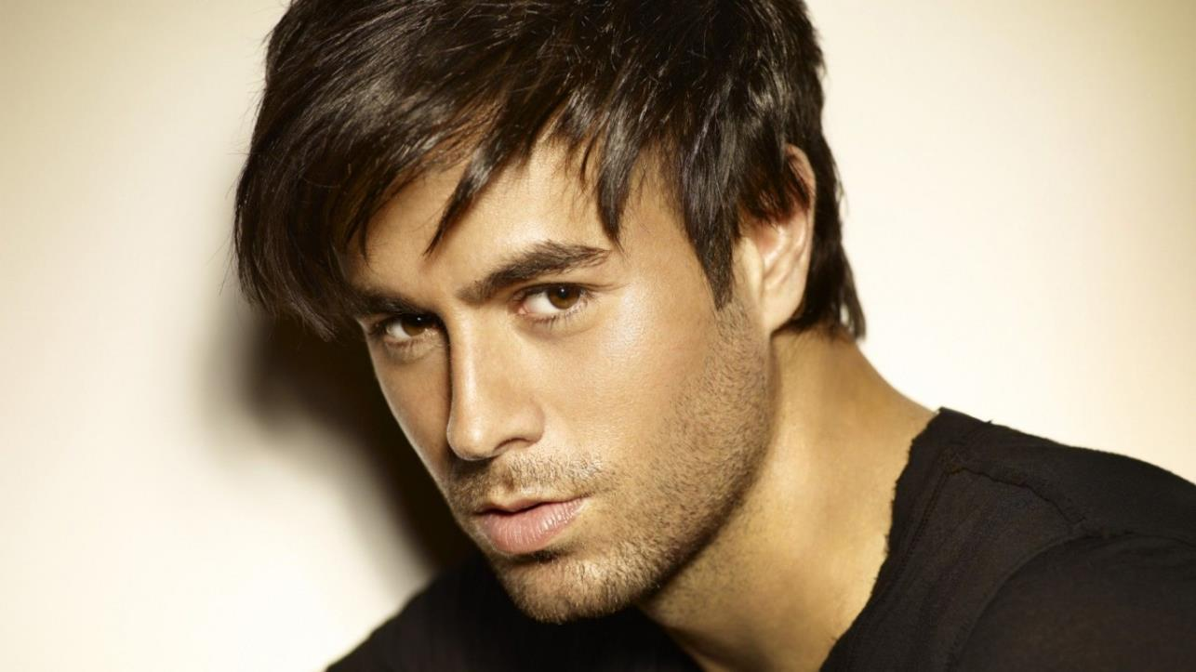
ENRIQUE IGLESIAS

Slide 45
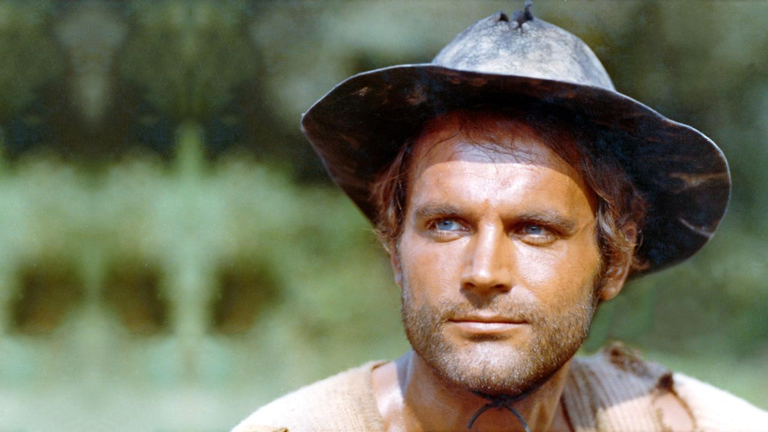
TERENCE HILL

Slide 46
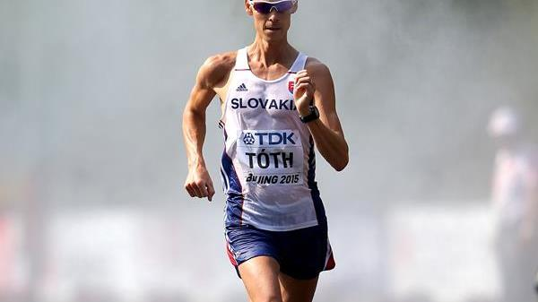
MATEJ TÓTH

Slide 47
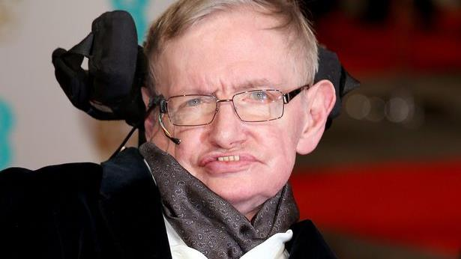
STEPHEN HAWKING

Slide 48
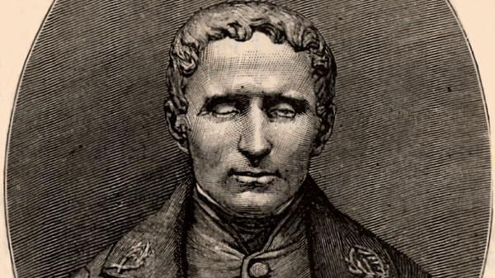
LOUIS BRAILLE

Slide 49
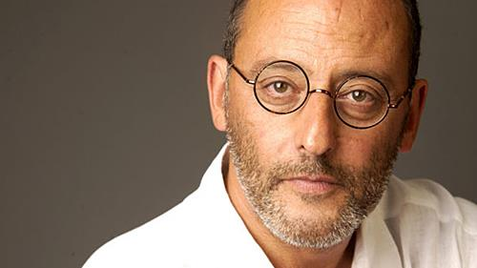
JEAN RENO

Slide 50
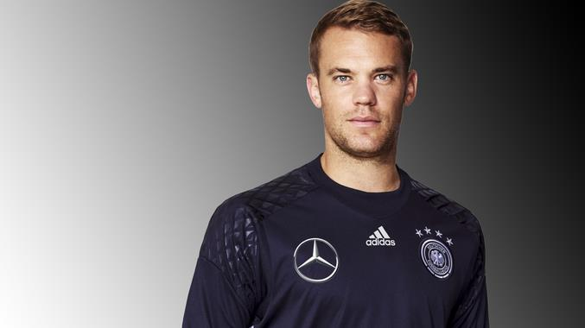
MANUEL NEUER

Slide 51
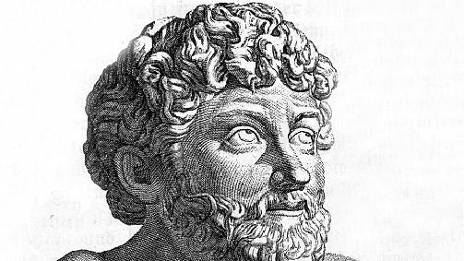
EZOP

Slide 52
EVANGELISTA TORRICELLI

Slide 53
PETRA VLHOVÁ

Slide 54
EMMANUEL MACRON

Slide 55
ALFRED NOBEL

Slide 56
ALLESANDRO VOLTA

Slide 57
PYTAGORAS

Slide 58
JAROMÍR JÁGR

Slide 59
ISAAC NEWTON

Slide 60
HOMÉR

Slide 61
BORIS BECKER

Slide 62
ANTOINE de SAINT-EXUPÉRY

Slide 63
JAMES WATT

Slide 64
ANGELA MERKELOVÁ

Slide 65
MICHAEL FARADAY

Slide 66
FRANCESCO PETRARCA

Slide 67
NIKOLA TESLA

